Slide 1
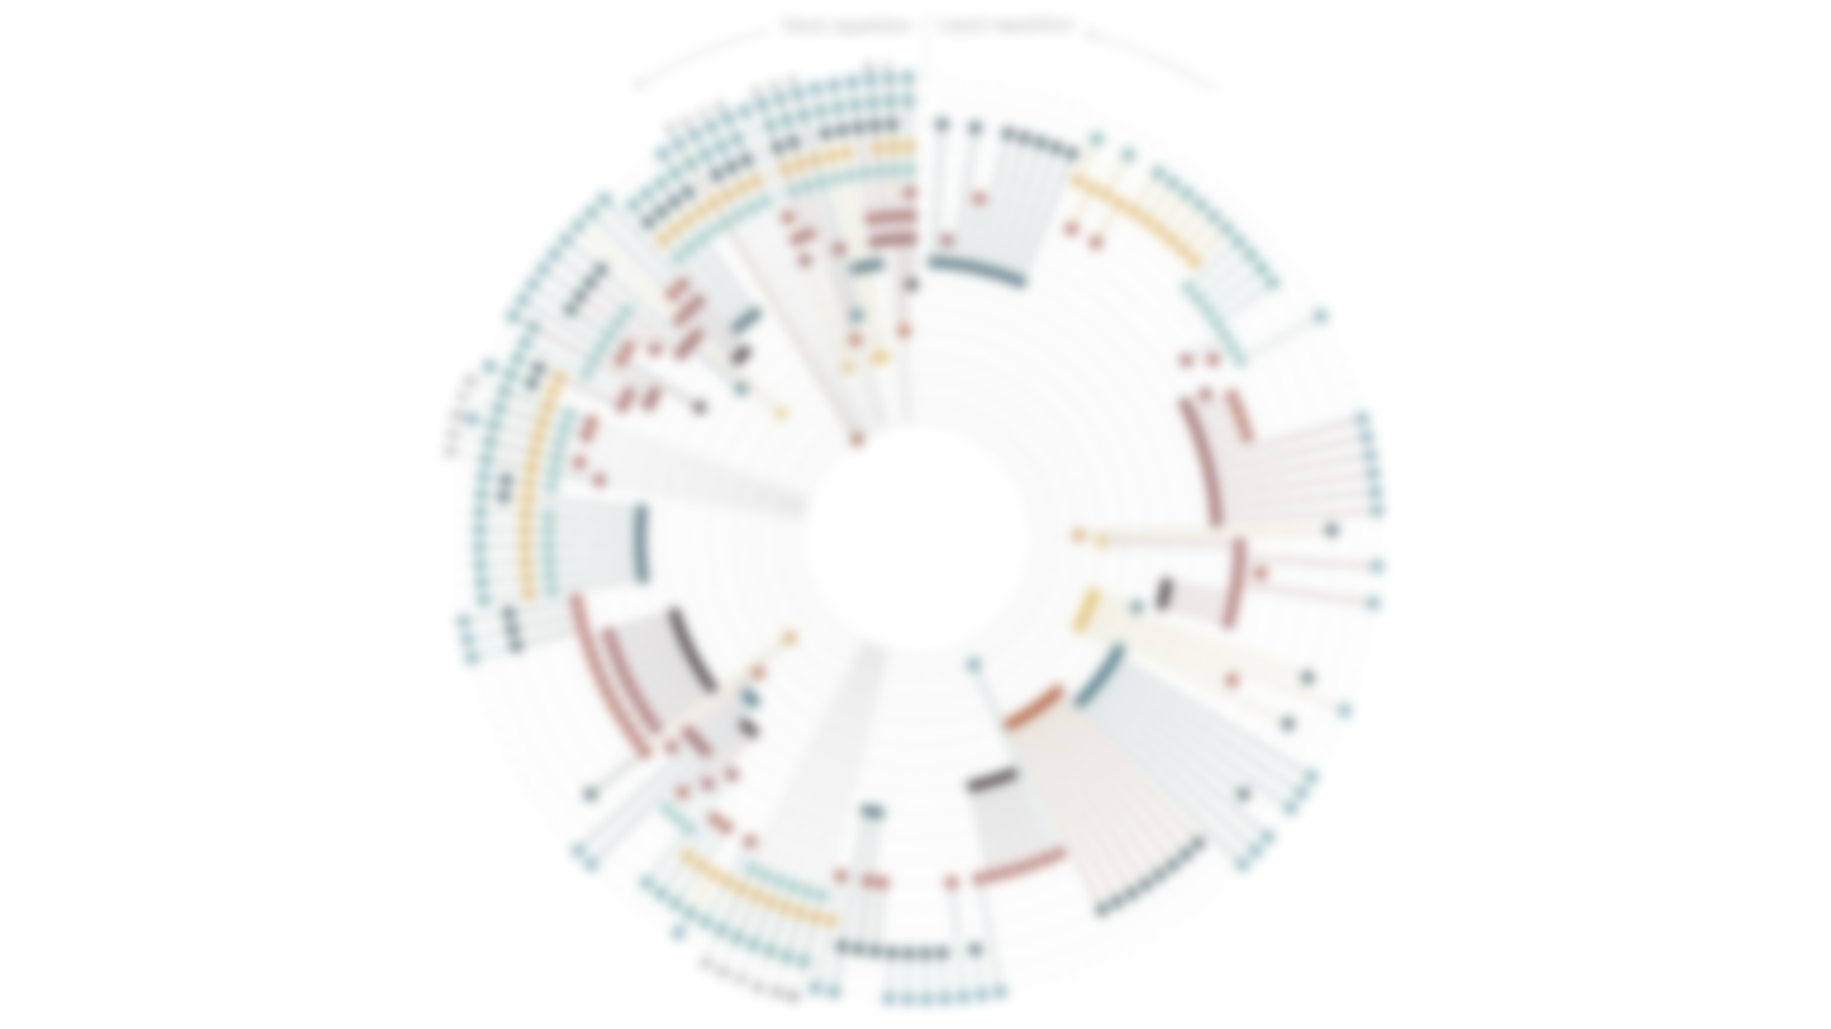
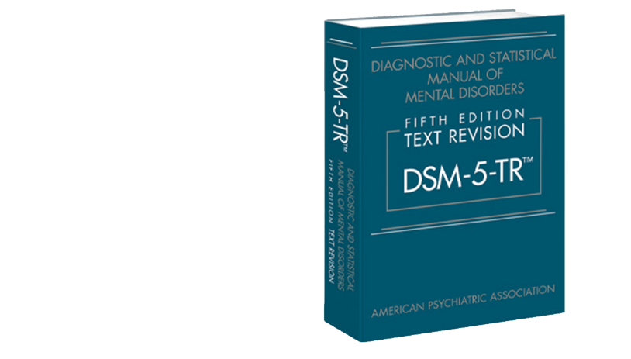
Elemental Psychopathology:
Distilling Constituent Symptoms and Patterns of Repetition
in The Diagnostic Criteria of The DSM-5
Notes:
Hello everyone, it's great to be here today to talk about a fascinating article that I recently came across.
The article is titled "Elemental Psychopathology: Distilling Constituent Symptoms and Patterns of Repetition in The Diagnostic Criteria of The DSM-5". It explores an important issue within the DSM-5, namely, the overlap of symptoms between different diagnostic criteria.
As you may know, the DSM-5 is a widely used manual for mental health professionals to diagnose and classify mental disorders.
However, with so many different diagnostic criteria included in the manual, it can be difficult to disentangle the unique symptoms of each disorder, and many diagnostic criteria have overlapping symptoms.
This is where the article comes in - it delves into the constituent symptoms and patterns of repetition in the DSM-5, shedding new light on the nature of mental disorders.

Slide 2
Introduction
Method
Result
Discussion
Notes:
Now, let me guide you through the introduction, method, result, and discussion of this exciting study.
Please note that I won't be strictly following the order of the article. Instead, I'll be incorporating my own interpretations and insights throughout the presentation.
While I've done my best to understand the article, there may be some inaccuracies or misunderstandings on my part. So please feel free to interrupt me if you have any questions or concerns.

Slide 3
Note
DSM – 5
It's boring but you gotta know
A Diagnostic System includes multiple Diagnostic Categories, each of which contains multiple Diagnostic Criteria.
If a person meets most of the diagnostic criteria in a particular diagnostic category, they will be diagnosed with a certain disease.
Diagnostic System
Diagnostic Category 1
Diagnostic Criteria a
Diagnostic Criteria b
Diagnostic Criteria c
…
Diagnostic Category 3
Diagnostic Criteria a
Diagnostic Criteria b
Diagnostic Criteria c
…
Diagnostic Category 2
Diagnostic Criteria a
Diagnostic Criteria b
Diagnostic Criteria c
…
Diagnostic Category 3
Diagnostic Criteria a
Diagnostic Criteria b
Diagnostic Criteria c
…
Notes:
Before we dive into the introduction, I'd like to introduce a few concepts that will come up later in the presentation.
When I was reading the article, these concepts confused me, so I want to clarify their relationships beforehand.
A diagnostic system includes multiple diagnostic categories, each of which contains multiple diagnostic criteria.
If a person meets most of the diagnostic criteria in a particular diagnostic category, they will be diagnosed with a certain disease.
Diagnostic system: A standardized method used to classify and describe various health problems
For example, DSM-5 and ICD-11 are two common diagnostic systems.
Diagnostic category: A classification in a diagnostic system used to describe common features and symptoms of a particular health problem.
For example, depression, generalized anxiety disorder, and schizophrenia in DSM-5 are different diagnostic categories.
Diagnostic criteria: A set of criteria that must be met by a group of symptoms to determine a specific diagnosis.

Slide 4
Note
DSM – 5
It's boring but you gotta know
In a Diagnostic System, each Diagnostic Category usually has a set of Symptom descriptions associated with it to help doctors or other healthcare professionals make a diagnosis.
A Core Symptom and several Constituent Symptoms constitute the Diagnostic Criteria for a certain disease
Core
Symptoms
Symptom a
Symptom b
Symptom c
Diagnostic Category
Symptom d
Symptom e
Symptom f
Symptom g
Symptom h
Symptom i
Symptom j
Constituent
Symptoms
Diagnostic Criteria c
Notes:
In a diagnostic system, each diagnostic category usually has a set of symptom descriptions associated with it to help doctors or other healthcare professionals make a diagnosis.
Constituent symptoms: Individual symptoms that make up a diagnosis or diagnostic criteria.
Core symptoms: The necessary basic symptoms in a diagnosis.
A Core Symptom and several Constituent Symptoms constitute the Diagnostic Criteria for a certain disease

Slide 5
Introduction
Notes:
I should note that my understanding of the relationship between diagnostic criteria and core symptoms is based on my own interpretation.
However, I believe that this hierarchical relationship is in line with the concepts presented in the article and will help you better understand the study.
Now, let's move on to the introduction.

Slide 6
Introduction
DSM – 5
DSM-5: Time for an Upgrade
Due to the heterogeneity within diagnostic categories and symptom overlap across diagnostic categories, traditional mental disorder diagnostic systems (e.g., DSM) have limitations.
Isolating a single diagnostic category:
Restricts our understanding of the fundamental causes of symptoms (Bentall et al., 2012; Fried and Nesse, 2015; Parker, 2005)
Obscures commonalities between symptoms (Barlow, 2014)
For example, there is considerable overlap in symptoms between severe depression and generalized anxiety disorder, making it possible for a person to meet the criteria for both diagnoses.
Therefore, by examining patterns of symptom overlap, researchers can identify:
Common symptoms of multiple diseases
Symptoms unique to a specific disease
This helps improve the accuracy of diagnostic classification and can lead to more effective treatments targeted at specific symptoms or groups of symptoms.
Notes:
As we've seen, traditional diagnostic systems like the DSM have limitations due to the heterogeneity within diagnostic categories and symptom overlap across diagnostic categories.
In fact, isolating a single diagnostic category can restrict our understanding of the fundamental causes of symptoms, as noted by Bentall et al. (2012), Fried and Nesse (2015), and Parker (2005).
Additionally, it can obscure commonalities between symptoms, as pointed out by Barlow (2014).
For instance, severe depression and generalized anxiety disorder share many symptoms, which means that a person can meet the criteria for both diagnoses.
To address these challenges, researchers have looked at patterns of symptom overlap.
By doing so, they can identify common symptoms of multiple diseases and symptoms unique to a specific disease.
This approach has helped improve the accuracy of diagnostic classification and can lead to more effective treatments targeted at specific symptoms or groups of symptoms. By understanding the overlap and distinctions between symptoms, we can gain a better understanding of mental disorders and provide more personalized and effective treatments.
Reference
Bentall RP, Wickham S, Shevlin M, Varese F. Do specific early-life adversities lead to specific symptoms of psychosis? A study from the 2007 the adult psychiatric morbidity survey. Schizophrenia Bulletin 2012; 38: 734-740. doi: 10.1093/schbul/sbs049
Fried EI, Nesse RM. Depression sum-scores don't add up: Why analyzing specific depression symptoms is essential. BMC Medicine. 2015; 13: 72-72. doi: 10.1186/s12916015-0325-4
Parker G. Beyond major depression. Psychological Medicine. 2005; 35: 467-474. doi: 10.1017/S0033291704004210
Barlow DH, Sauer-Zavala S, Carl JR, Bullis JR, Ellard KK. The nature, diagnosis, and treatment of neuroticism: Back to the future. Clinical Psychological Science. 2014; 2: 344365. doi: 10.1177/216770261350553

Slide 7
Introduction
DSM – 5
Similar Studies Have Been Conducted Before
Similar research has been conducted in the past, examining patterns of symptom overlap
Borsboom et al.(2011) generated a symptom-level overlap network in DSM-IV-TR，
Tio et al.(2016) used the same method to examine symptom-level overlap in ICD-10
Forbes (2023) examined whether symptoms in DSM-5 are only due to comorbidity or correlation between diseases, or whether they do indeed have distinctive manifestations in certain diseases.
Notes:
Previous research has also explored the patterns of symptom overlap in various diagnostic systems.
For example, Borsboom and colleagues (2011) generated a symptom-level overlap network in DSM-IV-TR. Similarly,
Tio and colleagues (2016) used the same method to examine symptom-level overlap in ICD-10. More recently,
Forbes (2023) investigated whether symptoms in DSM-5 are solely a result of comorbidity or correlation between diseases, or whether they have unique manifestations in certain diseases. These studies have contributed to a better understanding of the complexities of mental health diagnosis and the need for more precise symptom-based approaches.
Reference
Borsboom D, Cramer AOJ, Schmittmann VD, Epskamp S, Waldorp LJ. The small world of psychopathology. PloS One. 2011; 6. doi: 10.1371/journal.pone.0027407
Tio P, Epskamp S, Noordhof A and Borsboom D. Mapping the manuals of madness: Comparing the ICD-10 and DSM-IV-TR using a network approach. International Journal of Methods In Psychiatric Research. 2016; 25: 267-276. doi: 10.1002/mpr.1503
Forbes MK. Implications of the symptom-level overlap among DSM diagnoses for dimensions of psychopathology. Journal of Emotion and Psychopathology. 2023; 1(1): 104-112. doi: 10.55913/joep.v1i1.6

Slide 8
Introduction
DSM – 5
What This Study Aims to Do
This study uses a descriptive approach to address several questions:
How many different symptoms make up the hundreds of diagnostic criteria defined in DSM-5?
To what extent do these symptoms overlap within and across diagnostic categories?
What are the prominent patterns of symptom overlap between different diagnostic categories?
Are there any diagnostic categories that are more likely to exhibit symptom overlap than others?
Which symptoms are most repeated across different diagnostic categories?
Notes:
This study takes a descriptive approach to answer several important questions.
First, how many unique symptoms are included in the hundreds of diagnostic criteria outlined in DSM-5?
Secondly, to what extent do these symptoms overlap both within and across different diagnostic categories?
The study also seeks to identify the most prominent patterns of symptom overlap between different diagnostic categories
and whether certain categories are more likely to exhibit such overlap.
Finally, the study aims to determine which symptoms are most commonly repeated across different diagnostic categories.
By answering these questions, we can gain a deeper understanding of the relationships between symptoms and diagnostic categories, which can ultimately lead to more accurate diagnoses and effective treatments.

Slide 9
Method
Notes:
The next section is the Method.

Slide 10
Method
DSM – 5
Diagnostic Criteria were simplified to Core Symptoms
The DSM-5 Diagnostic Criteria were simplified to Core Symptoms using the following rules below based on Borsboom et al. (2011) and Tio et al. (2016):
Only adult psychopathology symptoms were included
Criteria with "or" were split into separate symptoms
Cause and consequence of symptoms were separated
Descriptive information related to timing, duration, frequency, and severity of symptoms was excluded
Only related special symptoms were listed once per disorder to avoid duplication
Special symptoms that described a new syndrome were considered independent criteria
Symptoms related to the cause, background, comorbidity, or mixed symptoms were not considered independent criteria
Notes:
In this study, we simplified the DSM-5 criteria for all diagnoses in Sections I-IX by using the rules established by Borsboom et al. (2011) and Tio et al. (2016).
We included only symptoms related to adult psychopathology
and split criteria containing "or" into separate symptoms.
We also separated the cause and consequence of symptoms
and excluded descriptive information related to timing, duration, frequency, and severity.
For each disorder listed in each chapter, we listed only related special symptoms once to avoid duplication in multiple disorders.
Finally, if a special symptom specified a new symptom or described a new syndrome, we considered it an independent diagnostic criterion.
However, if only the cause, background, comorbid symptom, subset/mixed symptom, etc. of the disorder was specified, it was not considered an independent diagnostic criterion.
Reference
Borsboom D, Cramer AOJ, Schmittmann VD, Epskamp S, Waldorp LJ. The small world of psychopathology. PloS One. 2011; 6. doi: 10.1371/journal.pone.0027407
Tio P, Epskamp S, Noordhof A and Borsboom D. Mapping the manuals of madness: Comparing the ICD-10 and DSM-IV-TR using a network approach. International Journal of Methods In Psychiatric Research. 2016; 25: 267-276. doi: 10.1002/mpr.1503

Slide 11
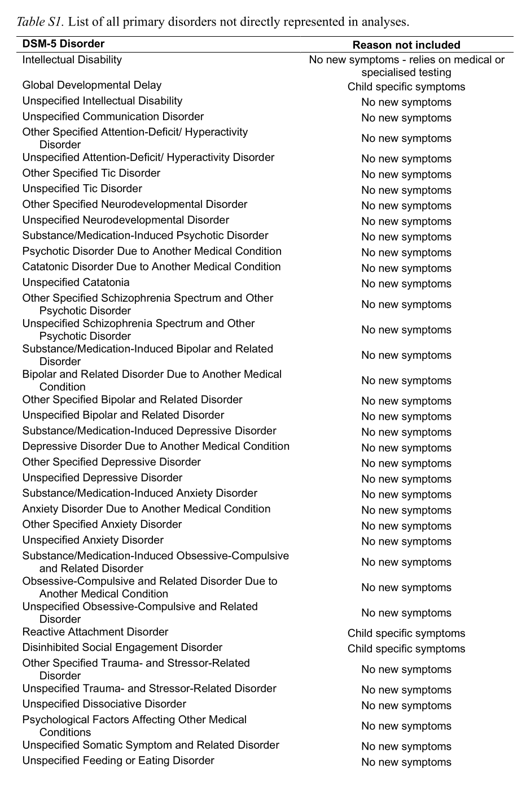
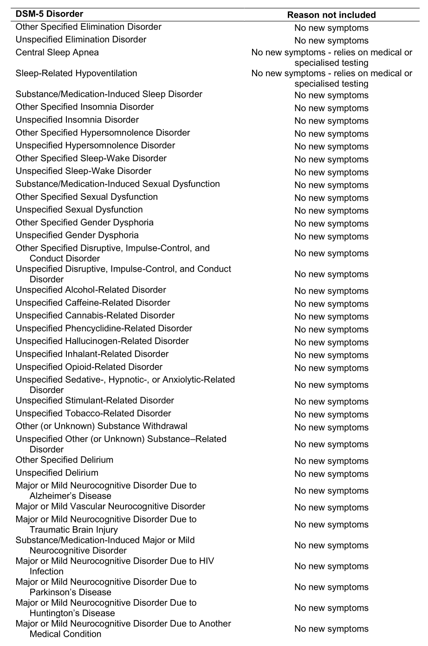
Method
DSM – 5
The Diseases Exclude from The Analysis
The diseases that do not meet the previous rules will not be included in the analysis,
totaling 85, of which 82 did not list any special symptoms (additional symptoms).
Notes:
The diseases that do not meet the previous rules will not be included in the analysis,

Slide 12


Method
DSM – 5
Testing Symptom Overlap with
Two Methods
(QCC & NLP)
Diagnostic Criteria can be ambiguous or vague, lacking specific details about Symptoms.
For instance, "significant cognitive decline" in neurocognitive disorders has no clear definition.
We'll use related symptoms and diagnostic criteria to specify each criterion for consistency in our analysis.
Our study will utilize Qualitative Content Coding and Natural Language Processing (NLP) to test for overlap among core symptoms.
Qualitative Content Coding
Natural Language Processing (NLP)
Notes:
In defining certain diagnostic criteria, there can be ambiguity or uncertainty due to the broad or abstract nature of some symptoms.
For instance, the symptom of "significant cognitive decline" in neurocognitive disorders lacks a clear definition for what "significant" means.
To address this issue, our project aims to reference related symptoms and diagnostic criteria to determine the specific content of each diagnostic criterion. This will ensure consistency in the analysis and enable us to identify patterns of symptom overlap among core symptoms.
To achieve this goal, we will utilize Qualitative Content Coding and Natural Language Processing (NLP) techniques. By doing so, we hope to improve our understanding of the complex relationships between different diagnostic categories and their symptoms, leading to more accurate and effective diagnoses and treatments.

Slide 13
Method
DSM – 5
Core Symptoms examined for content overlap using QCC
The core symptoms were examined for content overlap using Qualitative Content Coding.
The same symptoms were identified and labeled as the same.
Four members performed the following steps on these concepts:
Firstly, symptoms were assigned to emotional, behavioral, cognitive, or physical symptom categories.
Then, symptoms were further divided into subcategories.
For example, emotional symptoms were coded as low mood, high mood, mood swings, anxious mood, angry mood, and restricted affect.
Finally, symptoms were coded for content overlap within each subcategory, based on a heuristic rule, to determine whether multiple symptoms represented the same subjective experience.
For instance, depressed mood and low mood were considered the same subjective experience.
The entire process was repeated more than 90 times.
Notes:
We examined content overlap in core symptoms using Qualitative Content Coding.
The same symptoms were identified and labeled as the same.
Our team of four members
categorized symptoms into emotional, behavioral, cognitive, or physical categories,
then further subcategorized them.
For example, emotional symptoms were categorized into low mood, high mood, mood swings, anxious mood, angry mood, and restricted affect.
We then coded for content overlap within each subcategory to determine whether multiple symptoms represented the same subjective experience.
This process was repeated over 90 times.

Slide 14
Method
DSM – 5
Using NLP to Identify Possible Semantic Matches Missed
We used Natural Language Processing (NLP) to find semantic matches that might have been missed.
A model evaluated semantic similarity of symptom pairs to determine if they had the same meaning.
The pre-trained model scored remaining symptom pairs after filtering out duplicates..
Using five-fold cross-validation framework to evaluate the performance of the model.
The dataset was divided into five equal parts, with four used as the training set and one as the validation set for five model training and validation cycles to evaluate the model's performance.
Two researchers identified 26 new symptom pairs with semantic similarity among the top 1,000 pairs, resulting in a total of 3,096 matched pairs.
Notes:
This study utilized Natural Language Processing (NLP) to detect any potential semantic matches that may have been missed during the initial analysis.
To achieve this, a computational model was developed to assess the semantic similarity of symptom pairs and identify those with the same meaning. The model was pre-trained and validated using a five-fold cross-validation framework.
After filtering out previously identified matching pairs, the model was used to score the remaining pairs.
The top 1,000 pairs with the highest similarity scores were manually reviewed by two researchers, who identified 26 new matching pairs of symptoms. In total, the study found 3,096 matched pairs of symptoms.
This process allowed for a more comprehensive evaluation of symptom overlap and can contribute to more accurate diagnostic criteria.

Slide 15
Result
Notes:
Next is the Method.

Slide 16
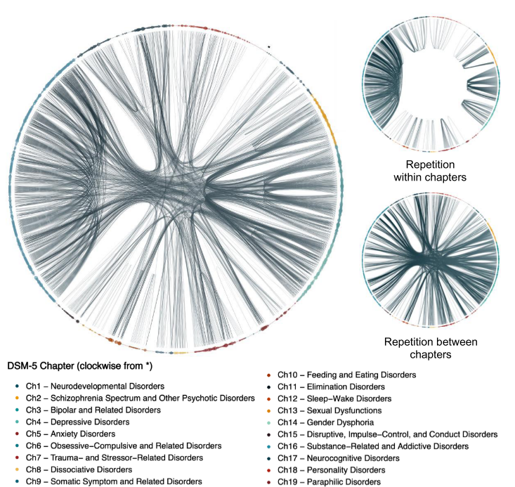
Result
DSM – 5
231(36.8%) of Symptoms were Repeated
Among 628 different symptoms,
397 (63.2%) distinct symptoms were unique to a single diagnosis
231 (36.8%) were non-single symptoms.
Non-single symptoms appeared a total of 1022 times, accounting for 72.0% of all symptoms listed in the diagnostic criteria.
Notes:
In the study, six hundred and twenty-eight different symptoms were identified.
Out of these,
three hundred and ninety-seven (sixty-three-point two percent) were single symptoms,
while two hundred and thirty-one (thirty-six-point eight percent) were non-single symptoms.
The non-single symptoms were observed a total of one thousand and twenty-two times,
which accounted for seventy-two-point zero percent of all symptoms listed in the diagnostic criteria.

Slide 17
Result
DSM – 5
How These Recurring Symptoms Repeat
Of these 231 symptoms that overlap between diagnoses
163 (70.6%) recurred in the same chapter
155 (67.1%) were repeated across multiple chapters
87 (37.7%) were repeated both within and between chapters
Notes:
Of these 231 symptoms that overlap between diagnoses.
One hundred and sixty-three (70.6%) of these symptoms recurred in the same chapter,
while one hundred and fifty-five (67.1%) were repeated across multiple chapters.
Additionally, eighty-seven (37.7%) of these symptoms were repeated both within and between chapters.

Slide 18
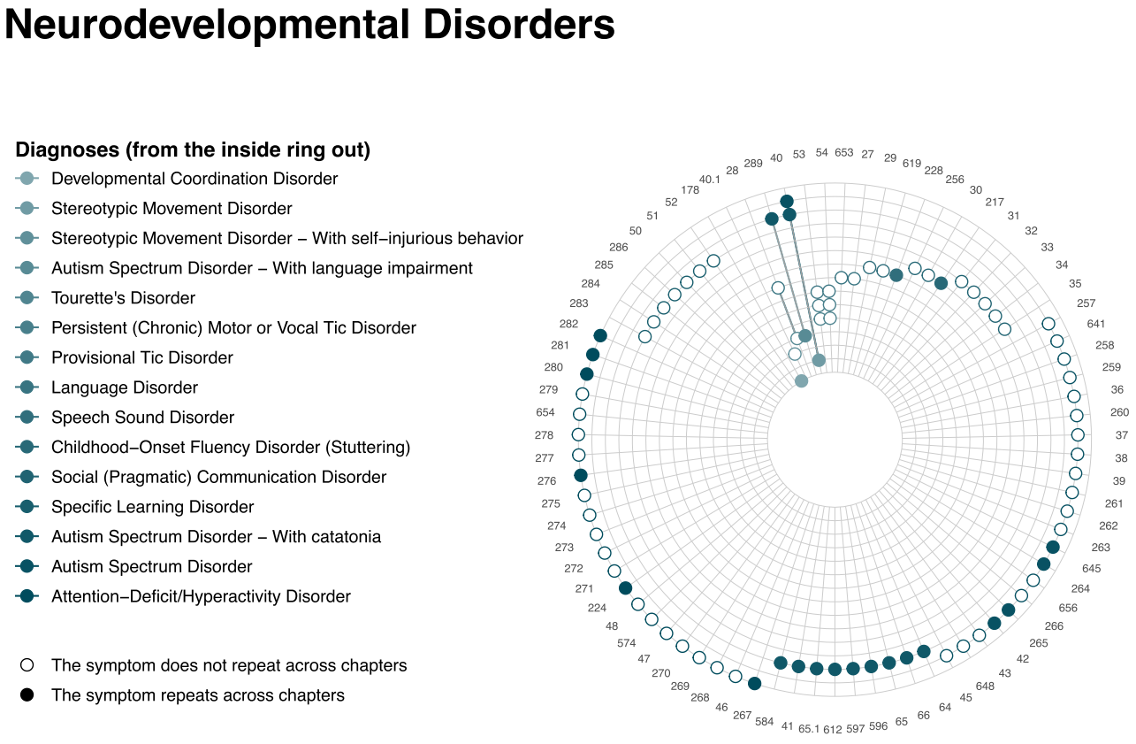
Result
DSM – 5
An Example of Repeated Symptoms
in a Diagnostic Category
140 diagnostic criteria (69.3%) had at least one symptom repeated in another diagnostic criteria
Notes:
These diagrams should be interpreted as follows:
Each concentric circle represents a diagnostic criterion, and different circles are marked with different shades of color.
The entire diagram represents the Diagnostic Criteria for a Diagnostic Category.
Each radius represents a symptom.
If a symptom appears in multiple diagnostic criteria, the intersection point where the line crosses multiple circles will be marked with a solid dot.
If a symptom appears only in one diagnostic criterion, then when the line crosses multiple circles, only one intersection point will appear as a hollow circle.
From these diagrams and the data, we can see that in fact, most symptoms do not repeat across different diagnostic criteria,
and only one-third of symptoms are repeatedly present across different diagnostic criteria.

Slide 19
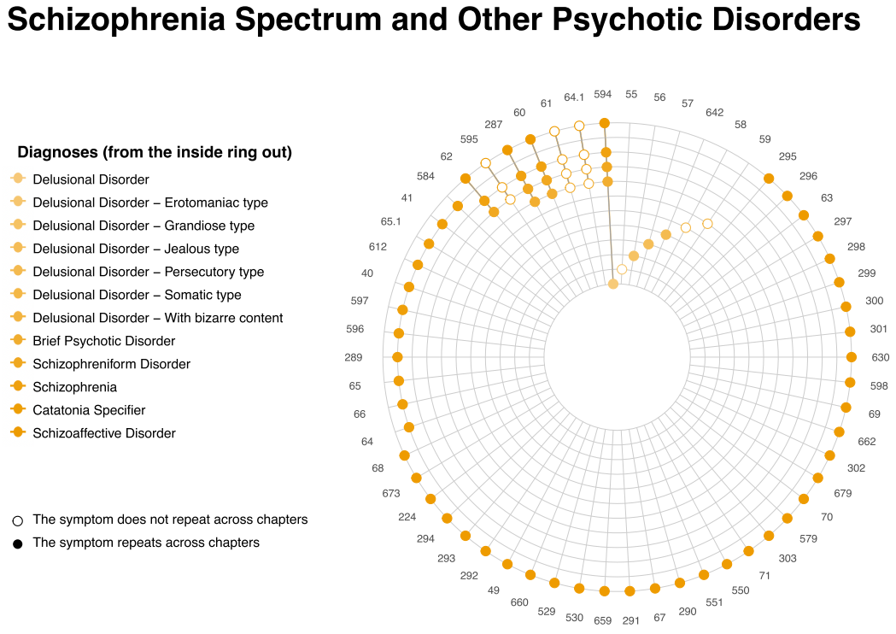
Result
DSM – 5
An Example of Repeated Symptoms
in a Diagnostic Category
118 diagnostic criteria (58.4%) were repeated in another chapter
Notes:
These diagrams should be interpreted as follows:
Each concentric circle represents a diagnostic criterion, and different circles are marked with different shades of color.
The entire diagram represents the Diagnostic Criteria for a Diagnostic Category.
Each radius represents a symptom.
If a symptom appears in multiple diagnostic criteria, the intersection point where the line crosses multiple circles will be marked with a solid dot.
If a symptom appears only in one diagnostic criterion, then when the line crosses multiple circles, only one intersection point will appear as a hollow circle.
From these diagrams and the data, we can see that in fact, most symptoms do not repeat across different diagnostic criteria,
and only one-third of symptoms are repeatedly present across different diagnostic criteria.

Slide 20
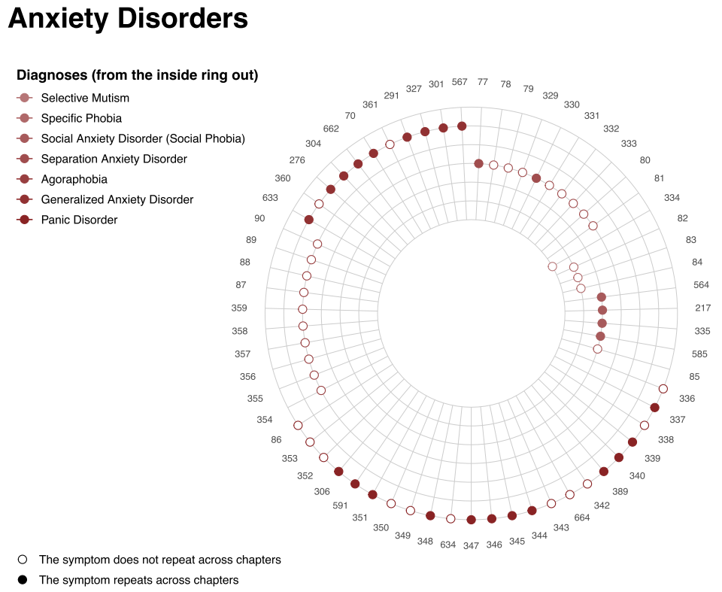
Result
DSM – 5
An Example of Repeated Symptoms
in a Diagnostic Category
Each symptom of 75 diagnostic criteria (37.1%) was repeated in at least one other diagnostic criteria
Notes:
These diagrams should be interpreted as follows:
Each concentric circle represents a diagnostic criterion, and different circles are marked with different shades of color.
The entire diagram represents the Diagnostic Criteria for a Diagnostic Category.
Each radius represents a symptom.
If a symptom appears in multiple diagnostic criteria, the intersection point where the line crosses multiple circles will be marked with a solid dot.
If a symptom appears only in one diagnostic criterion, then when the line crosses multiple circles, only one intersection point will appear as a hollow circle.
From these diagrams and the data, we can see that in fact, most symptoms do not repeat across different diagnostic criteria,
and only one-third of symptoms are repeatedly present across different diagnostic criteria.

Slide 21
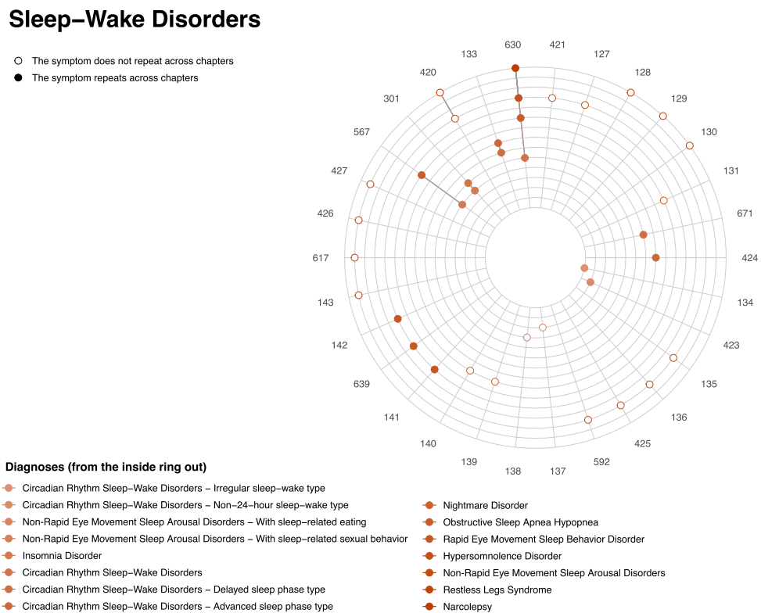
Result
DSM – 5
An Example of Repeated Symptoms
in a Diagnostic Category
Each symptom of 47 diagnostic criteria (23.3%) was repeated in other chapters
Notes:
These diagrams should be interpreted as follows:
Each concentric circle represents a diagnostic criterion, and different circles are marked with different shades of color.
The entire diagram represents the Diagnostic Criteria for a Diagnostic Category.
Each radius represents a symptom.
If a symptom appears in multiple diagnostic criteria, the intersection point where the line crosses multiple circles will be marked with a solid dot.
If a symptom appears only in one diagnostic criterion, then when the line crosses multiple circles, only one intersection point will appear as a hollow circle.
From these diagrams and the data, we can see that in fact, most symptoms do not repeat across different diagnostic criteria,
and only one-third of symptoms are repeatedly present across different diagnostic criteria.

Slide 22
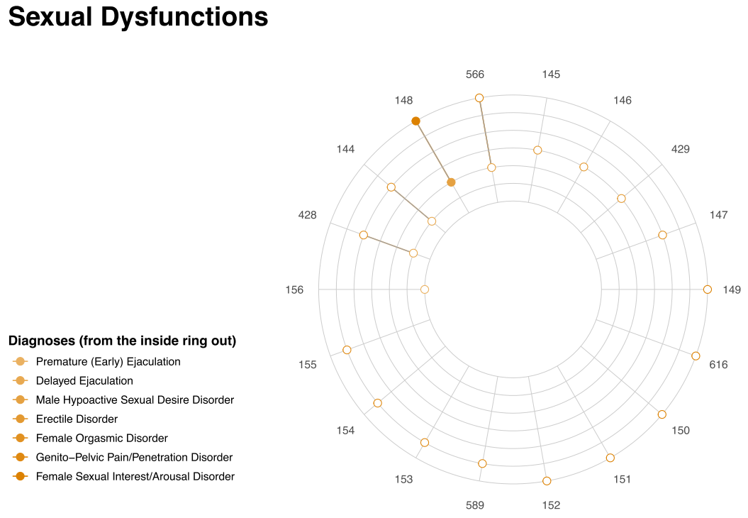
Result
DSM – 5
An Example of Repeated Symptoms
in a Diagnostic Category
62 diagnostic criteria (30.7%) had no symptom overlap, and 35 diagnostic criteria included only a single symptom
Notes:
These diagrams should be interpreted as follows:
Each concentric circle represents a diagnostic criterion, and different circles are marked with different shades of color.
The entire diagram represents the Diagnostic Criteria for a Diagnostic Category.
Each radius represents a symptom.
If a symptom appears in multiple diagnostic criteria, the intersection point where the line crosses multiple circles will be marked with a solid dot.
If a symptom appears only in one diagnostic criterion, then when the line crosses multiple circles, only one intersection point will appear as a hollow circle.
From these diagrams and the data, we can see that in fact, most symptoms do not repeat across different diagnostic criteria,
and only one-third of symptoms are repeatedly present across different diagnostic criteria.

Slide 23
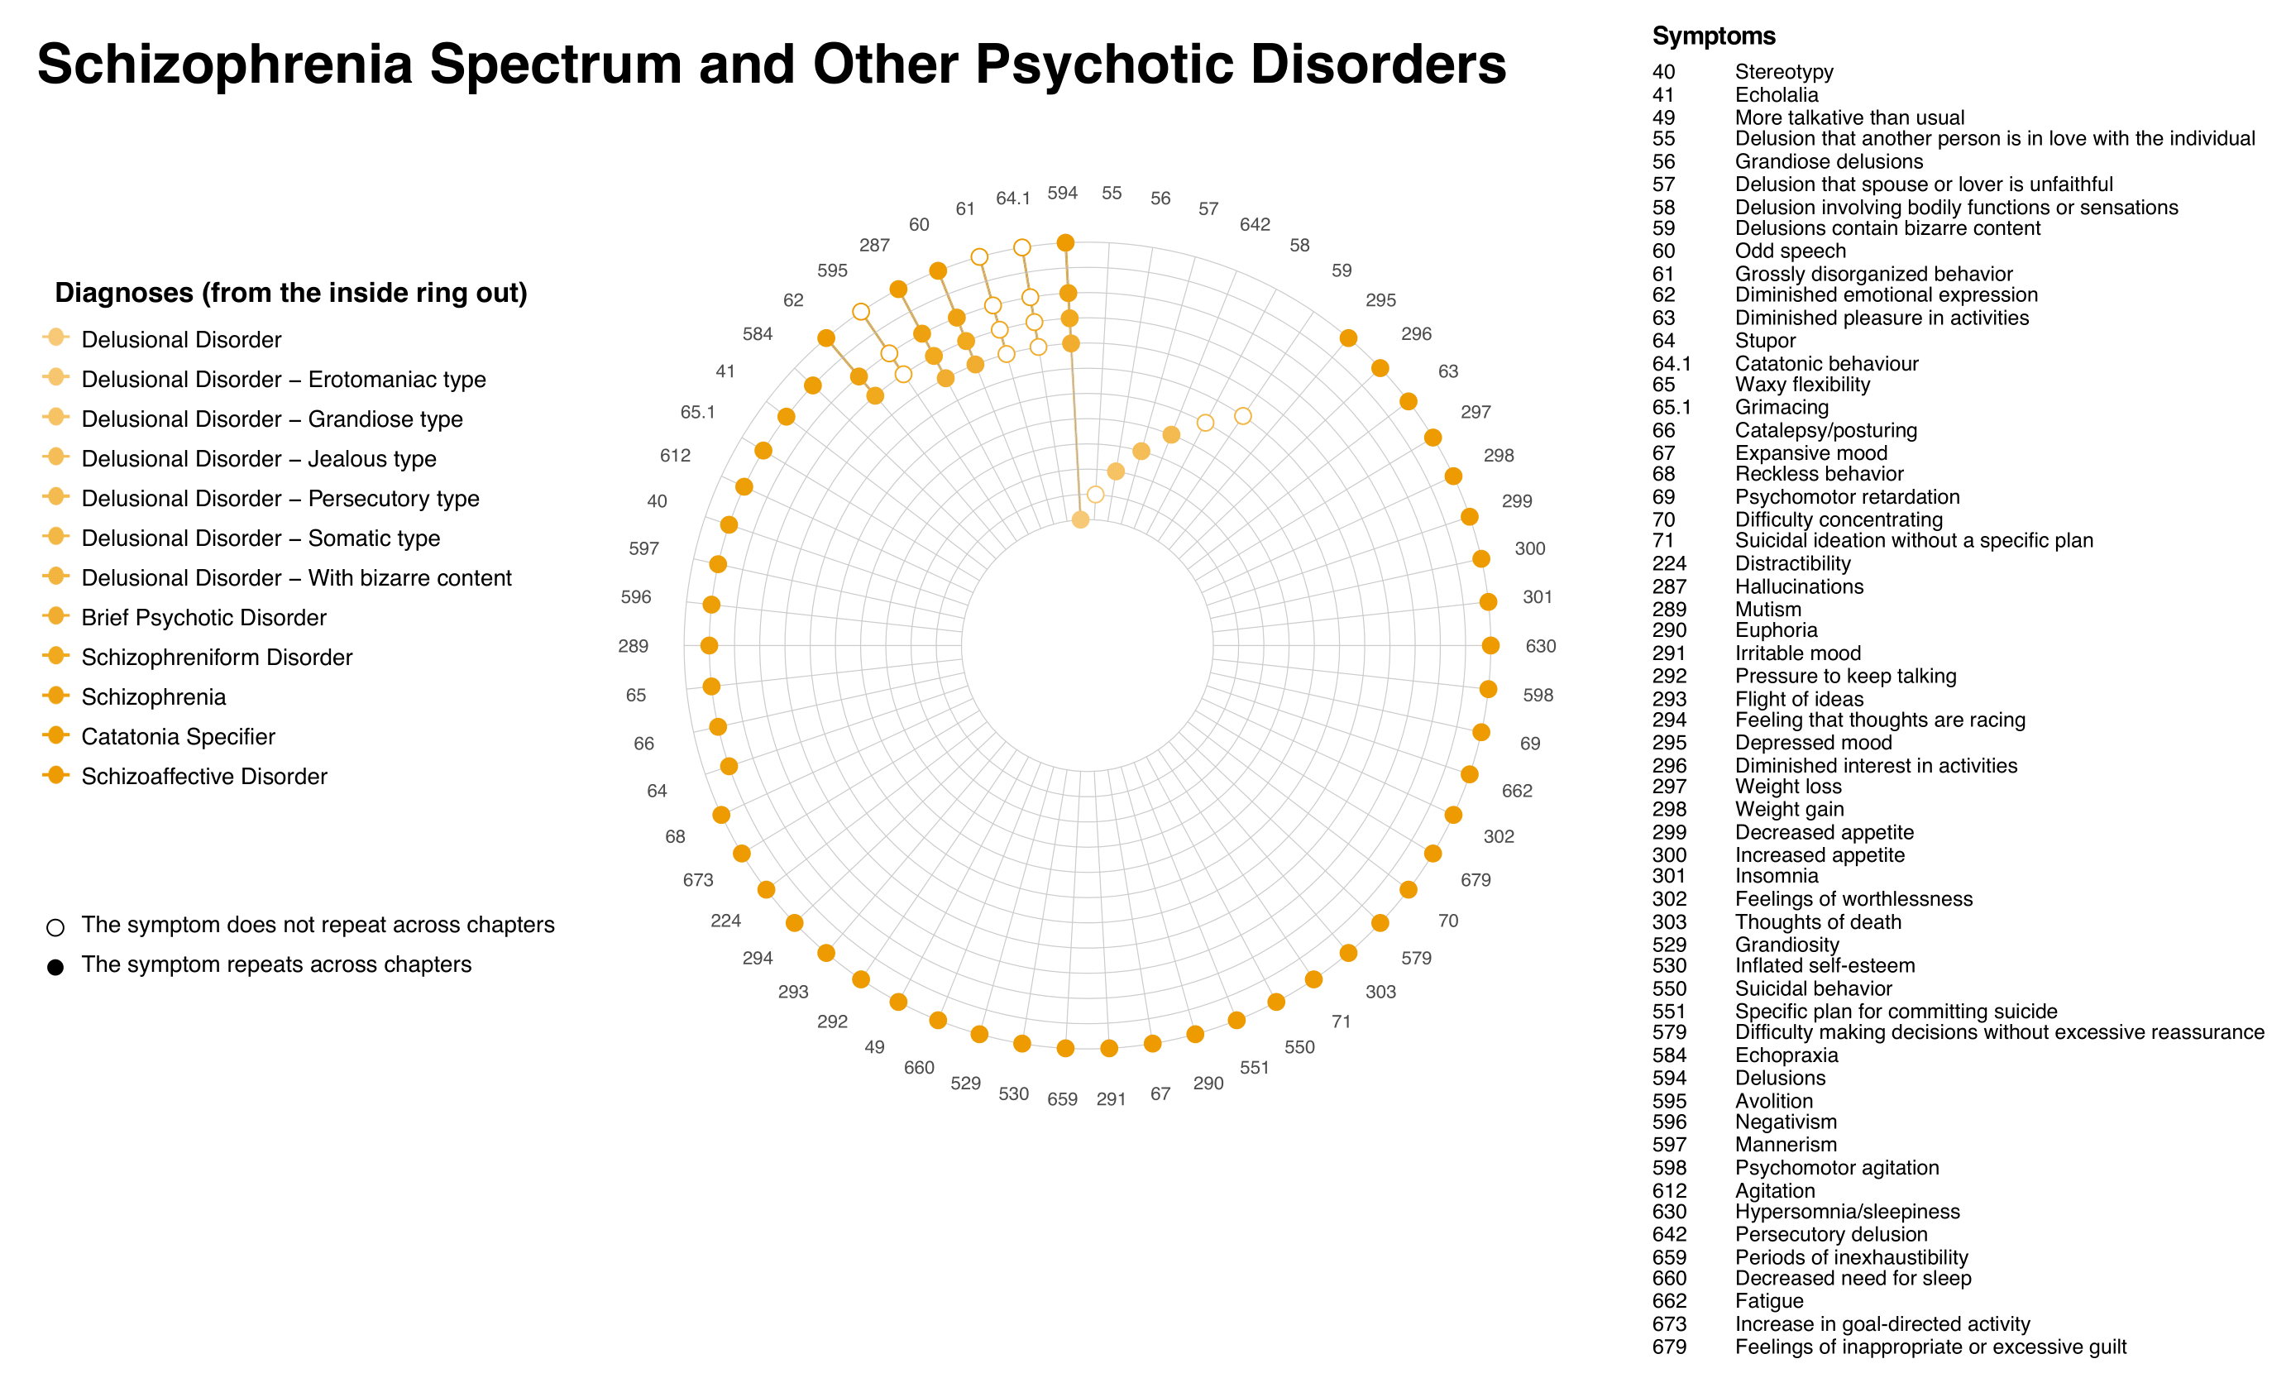
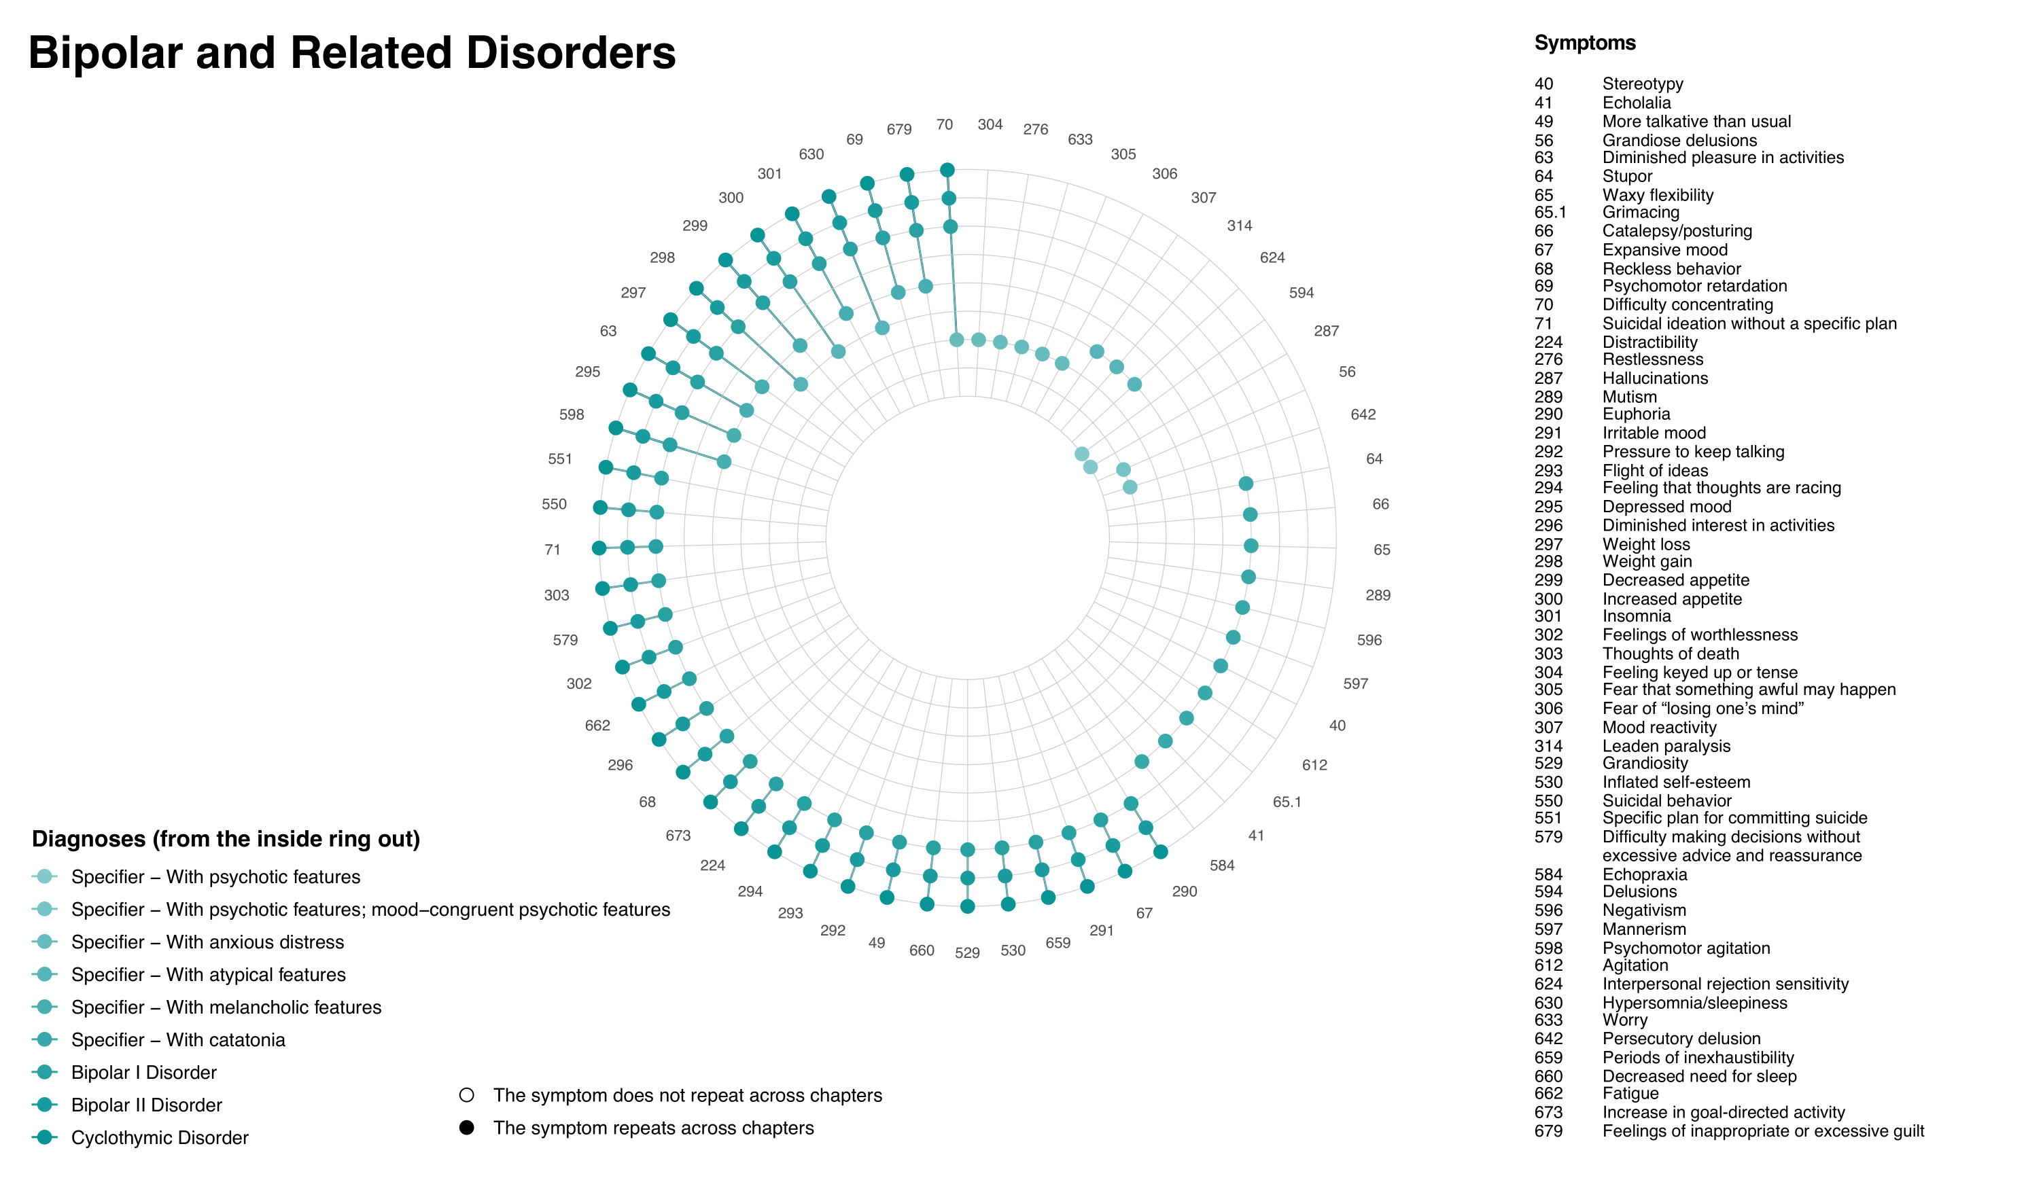
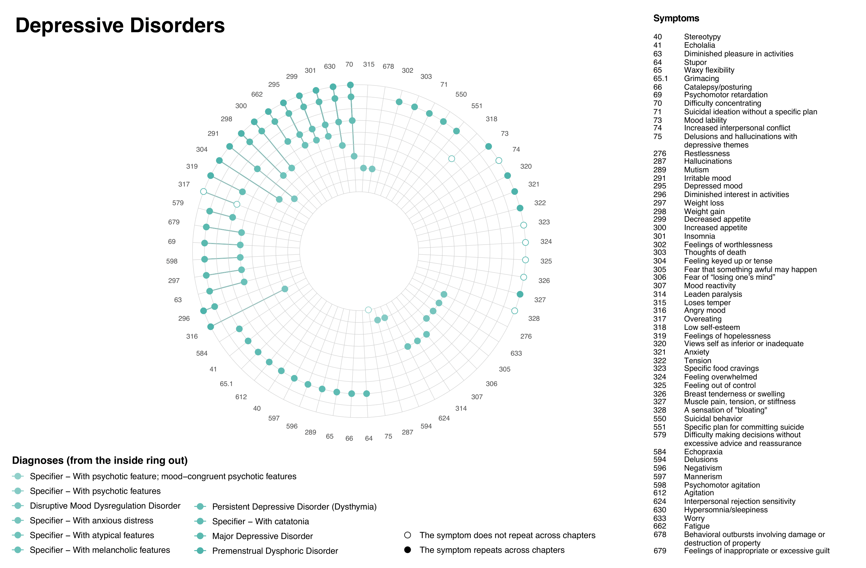
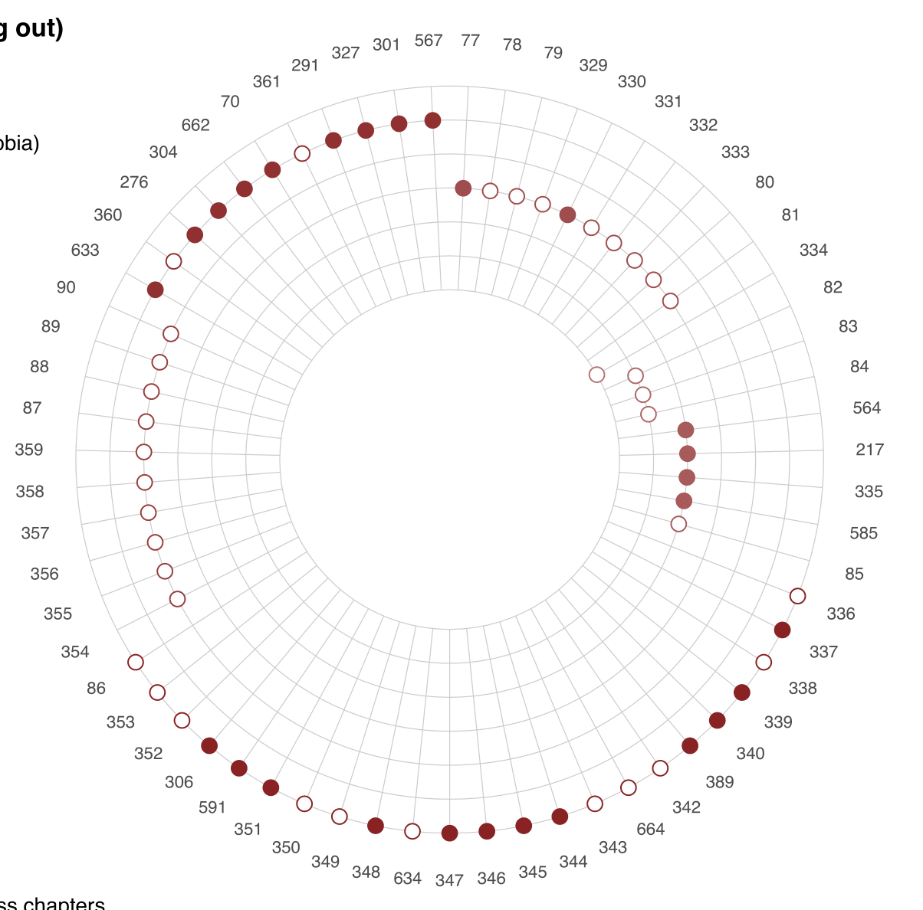
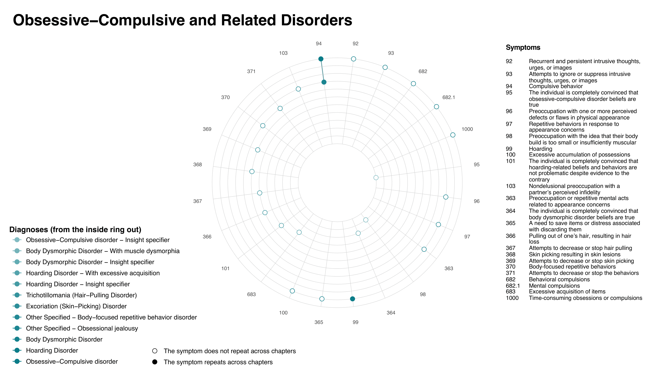
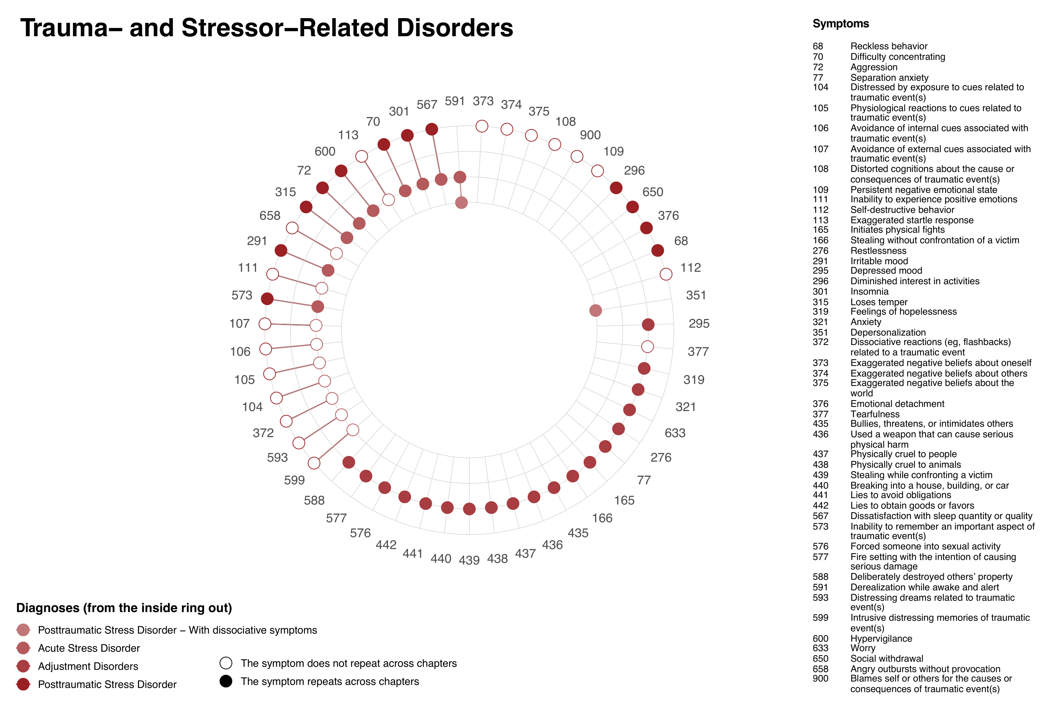
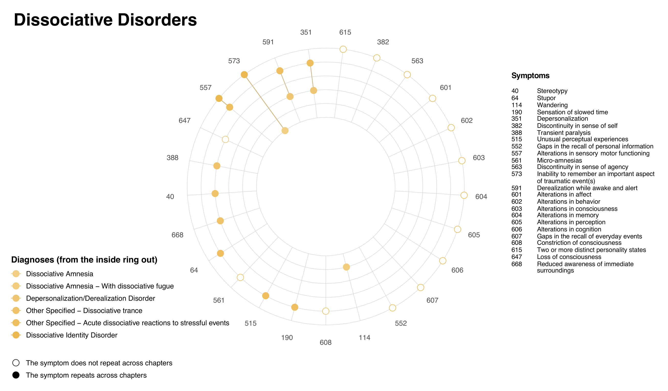
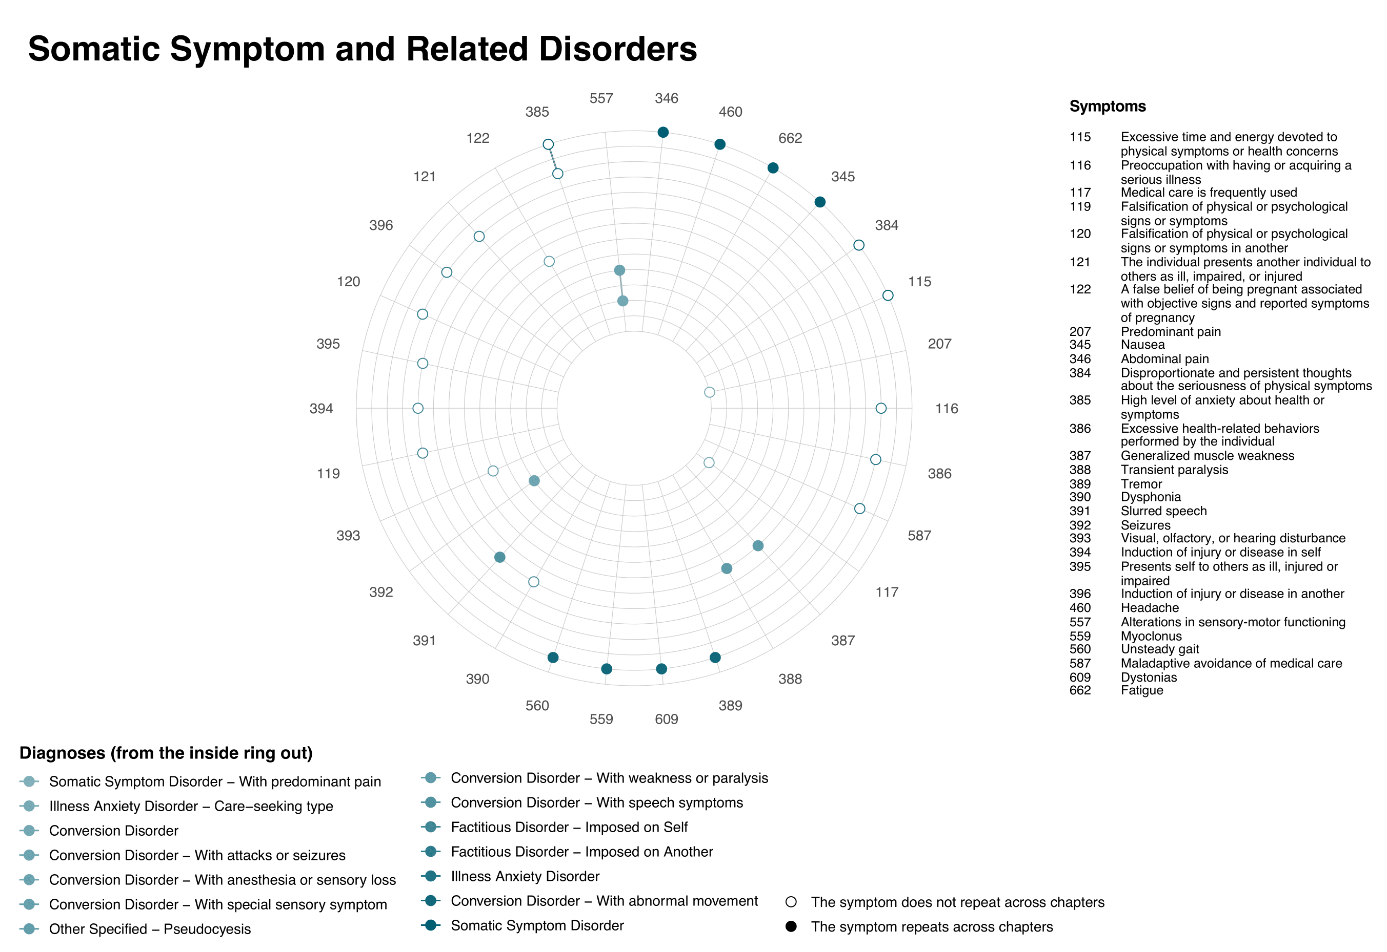
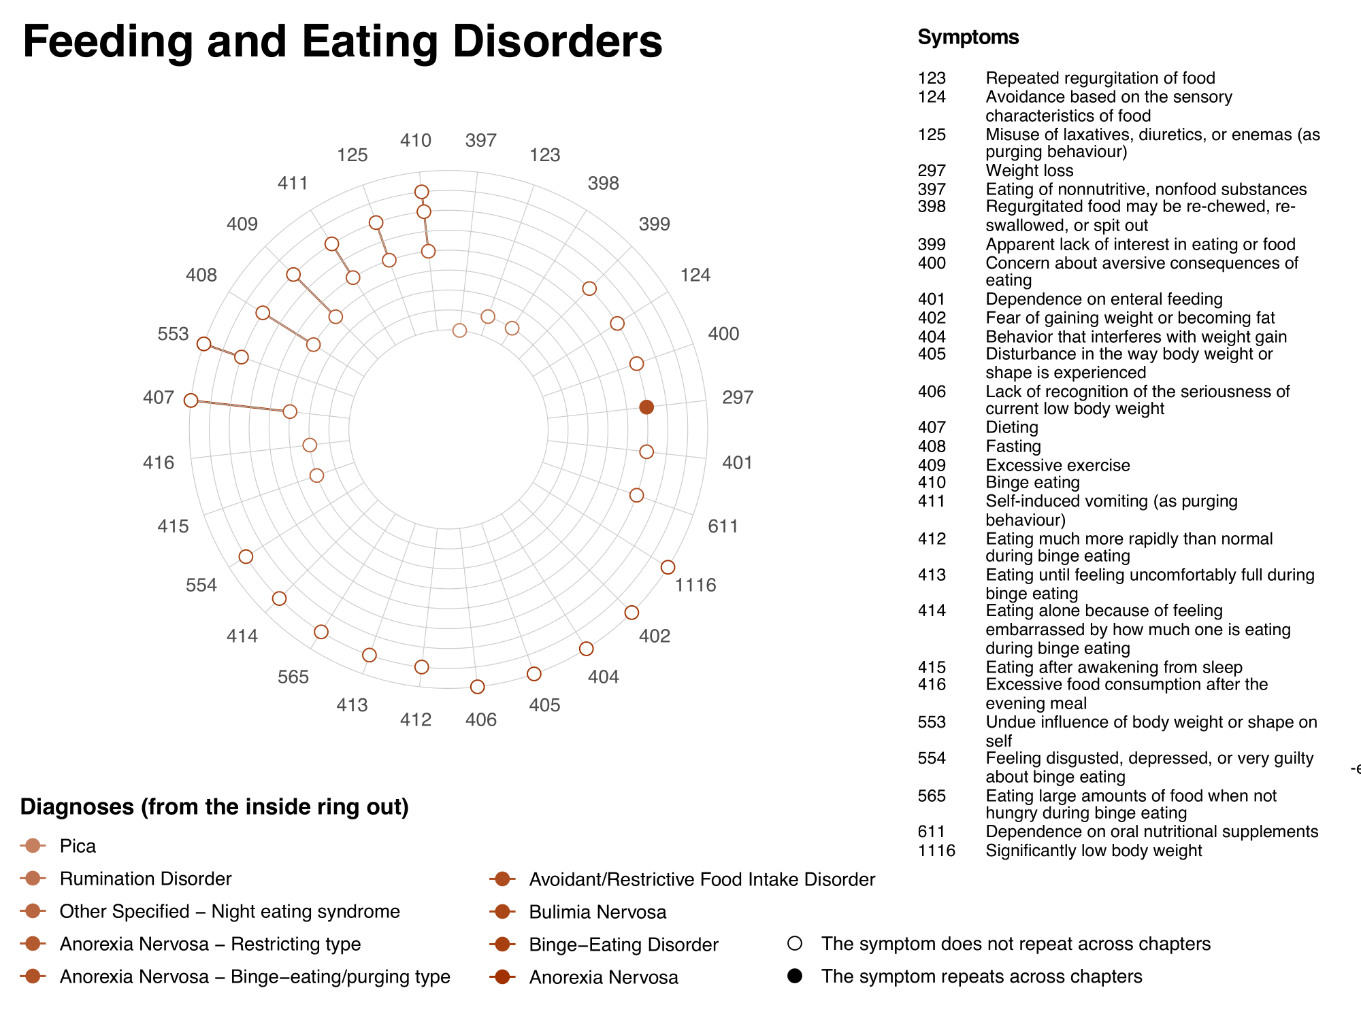
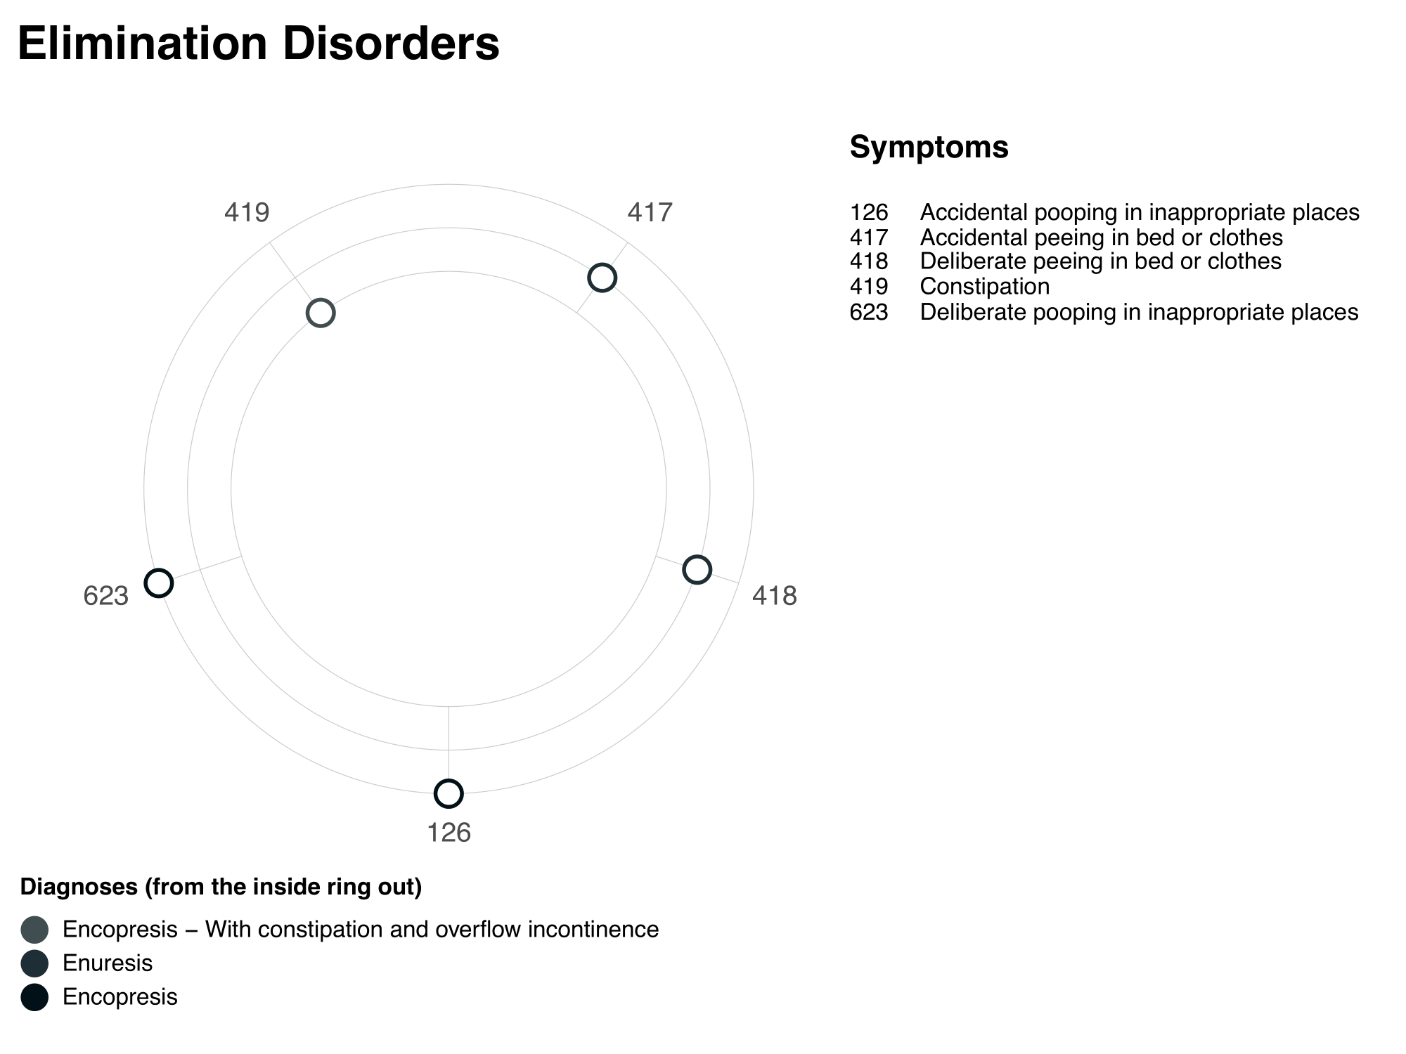
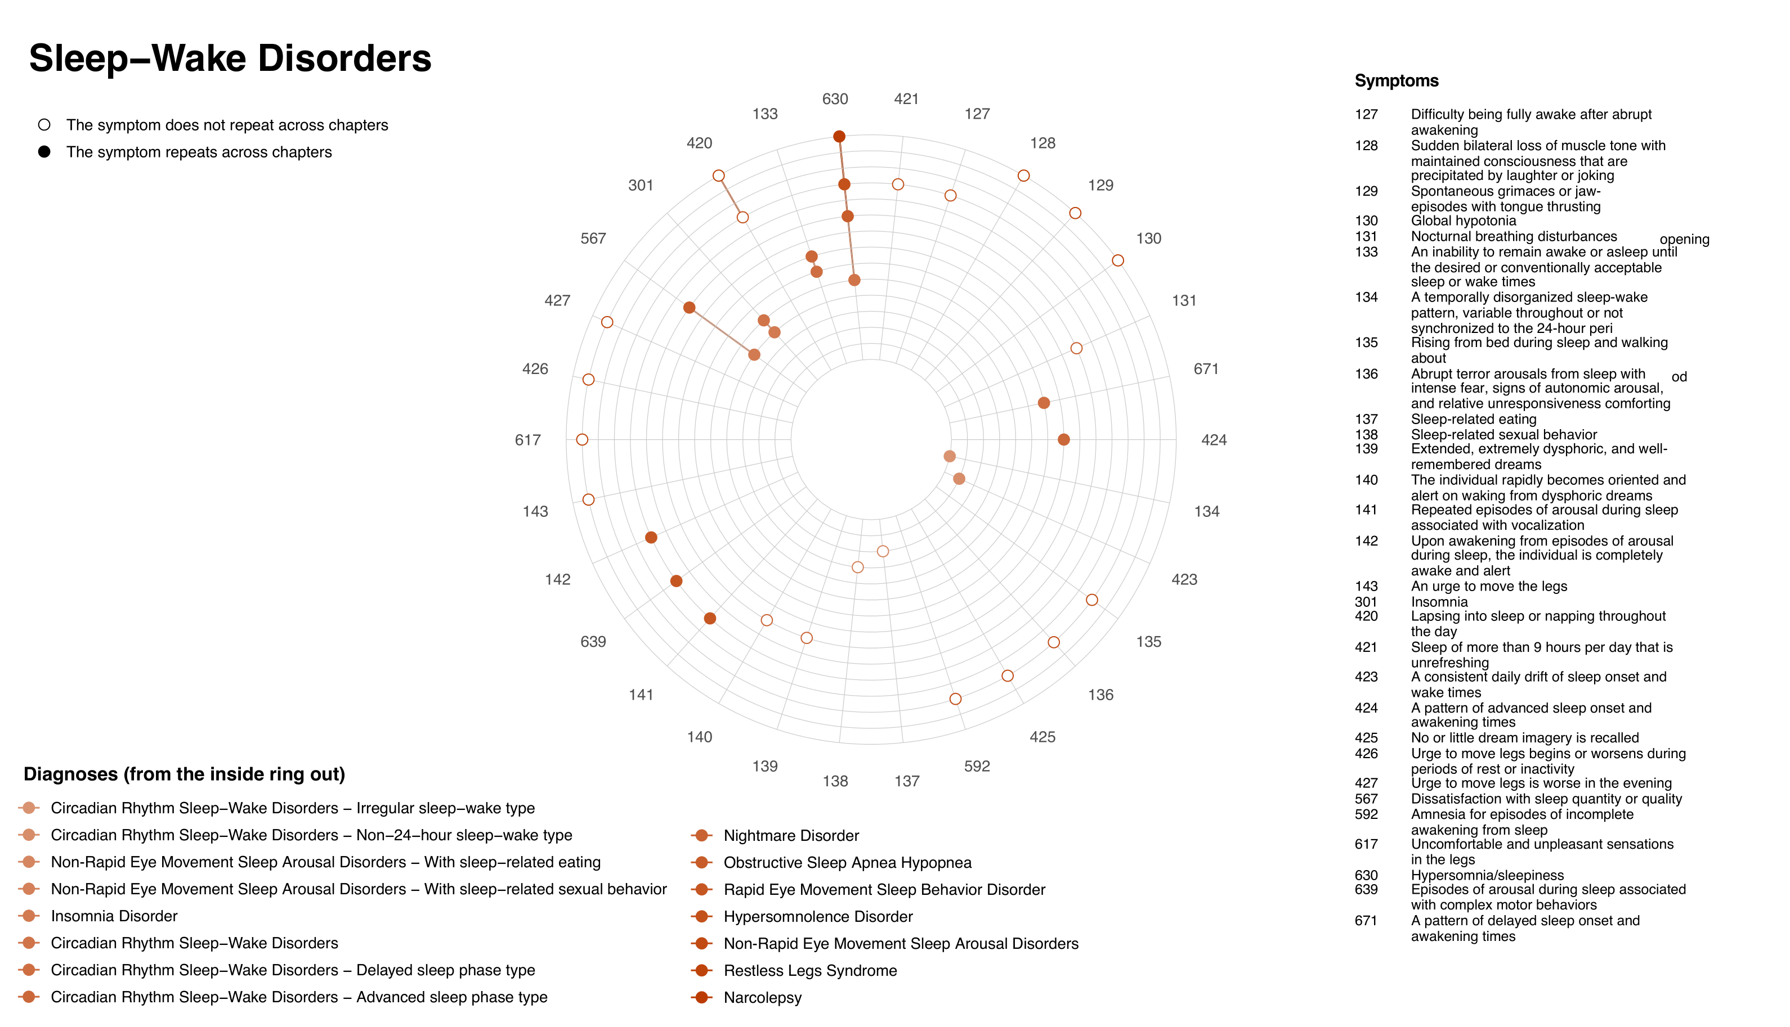
Result
DSM – 5
Other Repeated Symptoms in their Diagnostic Category
Notes:
These diagrams should be interpreted as follows:
Each concentric circle represents a diagnostic criterion, and different circles are marked with different shades of color.
The entire diagram represents the Diagnostic Criteria for a Diagnostic Category.
Each radius represents a symptom.
If a symptom appears in multiple diagnostic criteria, the intersection point where the line crosses multiple circles will be marked with a solid dot.
If a symptom appears only in one diagnostic criterion, then when the line crosses multiple circles, only one intersection point will appear as a hollow circle.
From these diagrams and the data, we can see that in fact, most symptoms do not repeat across different diagnostic criteria,
and only one-third of symptoms are repeatedly present across different diagnostic criteria.

Slide 24
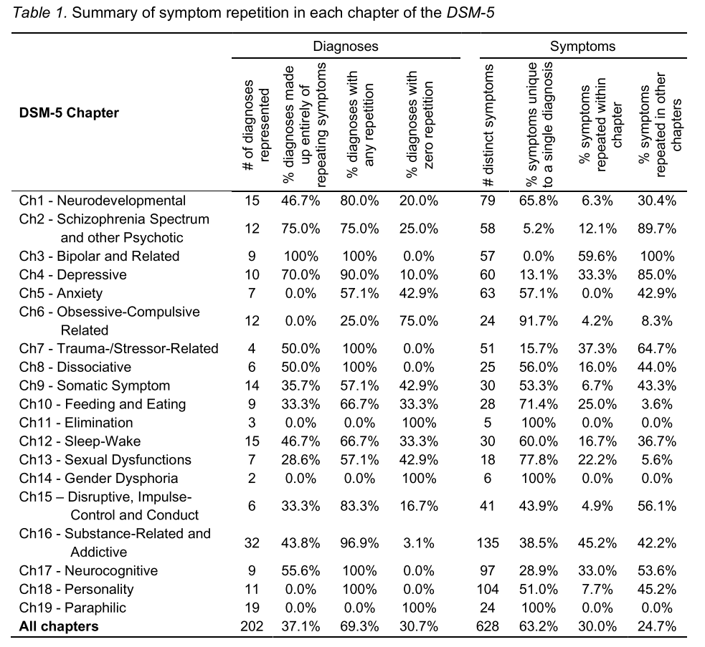
Result
DSM – 5
Symptom Duplication Varies Across Different Domains.
Some domains are more prone to duplication of symptoms than others
Notes:
Some domains are more prone to duplication of symptoms than others

Slide 25
Result
DSM – 5
Some Symptoms Do Not Duplicate At All,
Some symptoms mentioned in certain sections do not appear in any other diagnostic criteria
Notes:
Some symptoms mentioned in certain sections do not appear in any other diagnostic criteria
e.g., Elimination Disorders, Gender Dysphoria, or Paraphilic Disorders

Slide 26
Result
DSM – 5
While Others Frequently Appear In Other Diagnostic Criteria.
while in other sections, at least one symptom mentioned appears in other diagnostic criteria.
Notes:
while in other sections, at least one symptom mentioned appears in other diagnostic criteria.
e.g.，Bipolar and Related Disorders, Trauma- and Stressor Related Disorders, Dissociative Disorders, Neurocognitive Disorders, and Personality Disorders

Slide 27
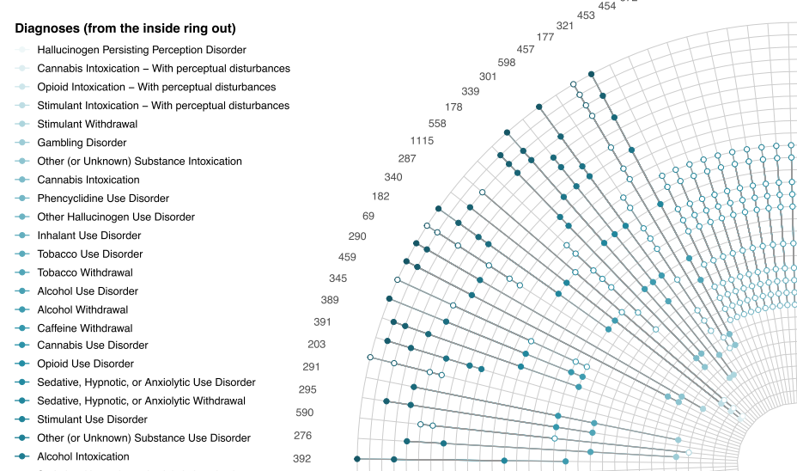
Result
DSM – 5
Symptoms of some diseases are highly overlapped
Repeatability of symptoms varies between diseases
Symptoms of some diseases are highly overlapped, e.g., Bipolar and Related Disorders、Schizophrenia Spectrum and Other Psychotic Disorders、Depressive Disorders、Trauma- and Stressor-Related Disorders、Neurocognitive Disorders and Disruptive, Impulse Control, and Conduct Disorders
Notes:
In general, Symptoms of some diseases are highly overlapped while Symptoms of some diseases are less overlapped.

Slide 28
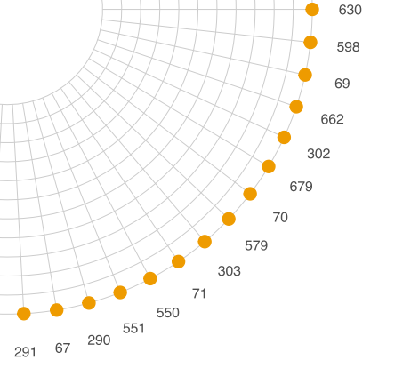
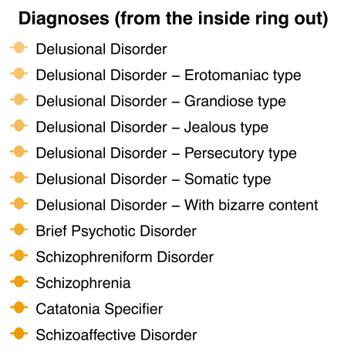
Result
DSM – 5
Symptoms of some diseases are less overlapped
Repeatability of symptoms varies between diseases
Symptoms of some diseases are less overlapped, e.g., Elimination Disorders、Gender Dysphoria、Paraphilic Disorders、Feeding and Eating Disorders、Sexual Dysfunctions and Obsessive-Compulsive Related Disorders
Notes:
In general, Symptoms of some diseases are highly overlapped while Symptoms of some diseases are less overlapped.

Slide 29
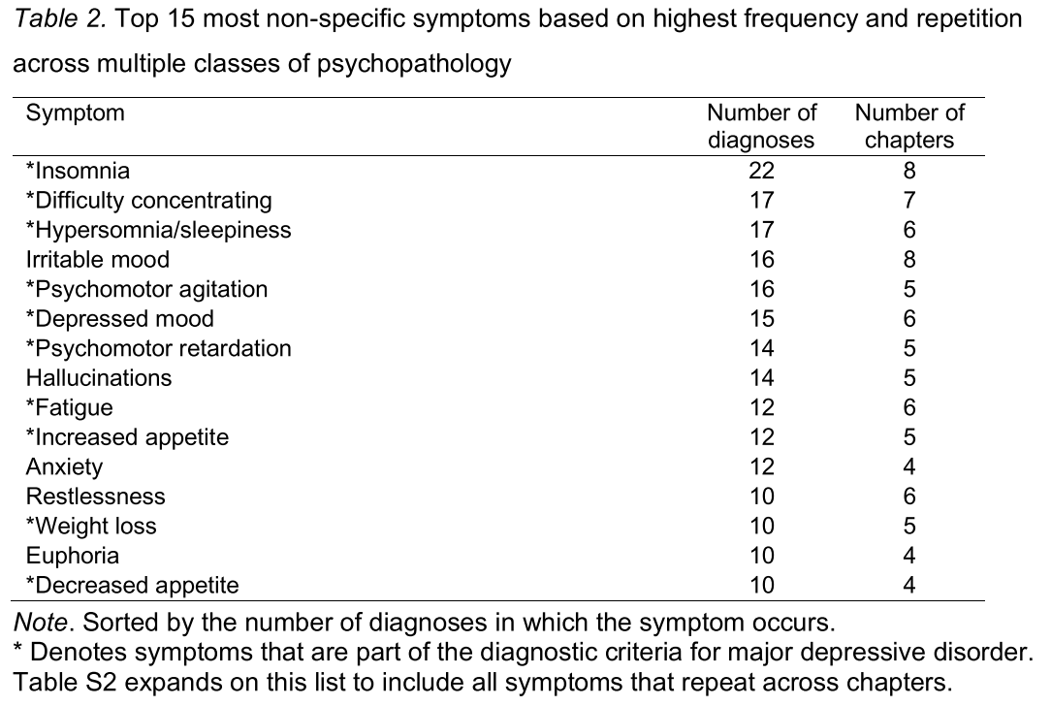
Result
DSM – 5
Most Non-Specific Symptom
Most Non-Specific Symptom
Notes:
We summarized which symptoms were most likely to be repeated in diagnoses and chapters.
For example, the top three symptoms that are prone to repetition are insomnia, difficulty concentrating, and hypersomnia.

Slide 30
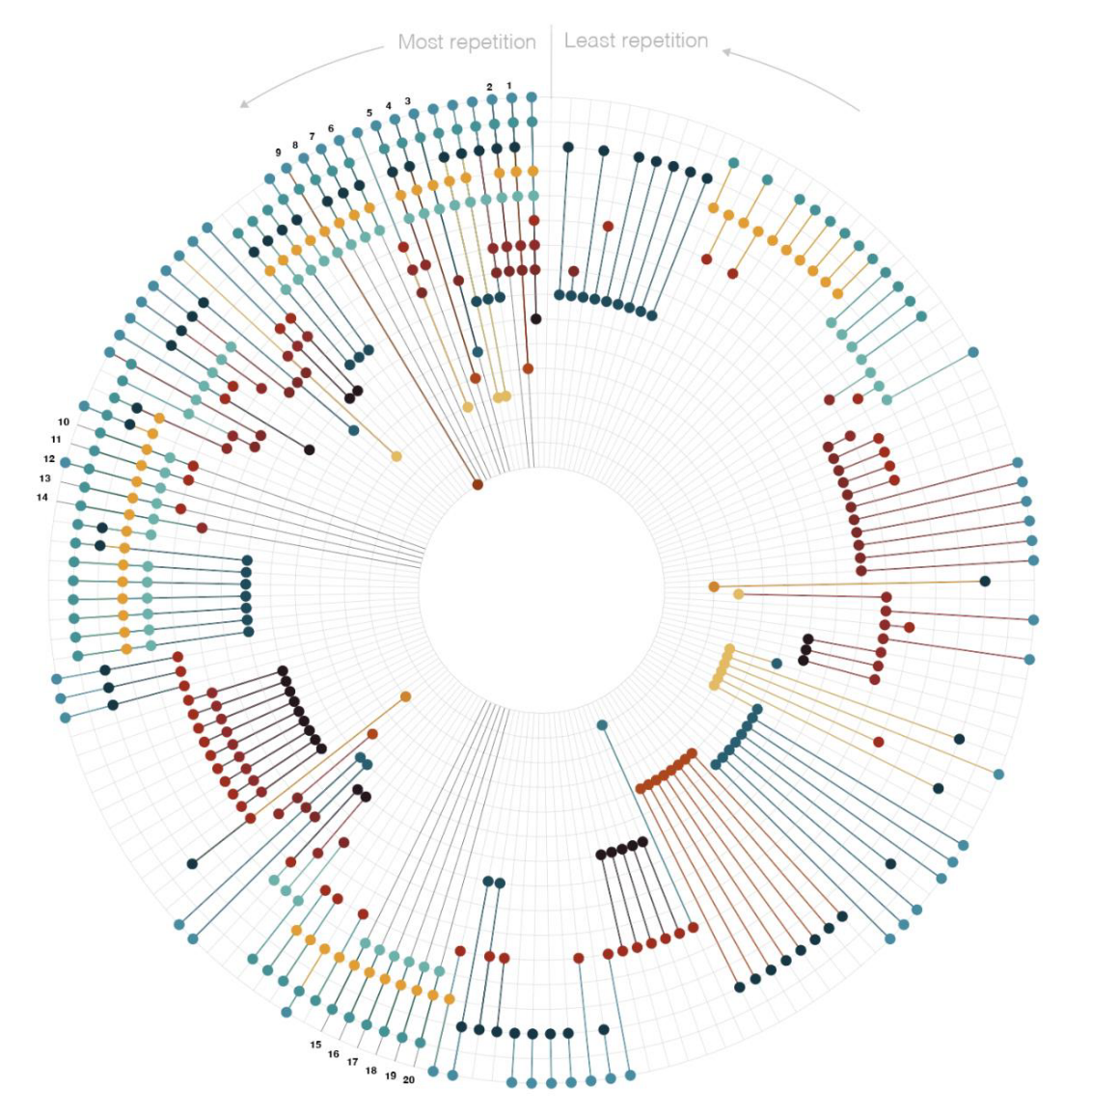
Result
DSM – 5
Visualized The Overlap Of Symptoms Across Chapters
Notes:
Of course, we also visualized the overlap of symptoms across chapters.
The symptoms with the highest frequency of repetition are arranged counterclockwise, while those with the lowest frequency of repetition are arranged clockwise.
Each vertical line extending from the center of the circle represents a symptom, and each concentric circle represents a chapter.
If the symptom appears in that chapter, a solid dot is placed on the circle representing that chapter (each chapter is represented by a different color).

Slide 31
Discussion
Notes:
Lastly, the discussion part.

Slide 32
Discussion
DSM – 5
Most symptoms are not repeated.
Symptom repetition may not be as common as initially thought
231 repeated symptoms spanned 140 diagnoses and 16 chapters.
Almost two-thirds of unique symptoms were associated with only one diagnostic criterion.
30% of diagnostic criteria had no repetition.
Notes:
At the end of the analysis, we found that symptom repetition may not be as common as initially thought
Almost two-thirds of unique symptoms were associated with only one diagnostic criterion.

Slide 33
Discussion
DSM – 5
Symptom repetition in chapters is intentional
The repetition of symptoms within chapters often appears to be by design
Disorders such as bipolar and related disorders, major depressive disorder, and others include both elevated and depressed moods;
Acute stress disorder and posttraumatic stress disorder have significant symptom overlap;
Core symptoms of various substance use disorders are also similar;
Neurocognitive disorders include deficits in complex attention, executive function, learning and memory, language, perceptual-motor skills, and social cognition.
The repetitive nature of depressive symptoms differs from other disorders.
Although depression and anxiety disorders share similarities, there are no overlapping symptoms.
Notes:
When looking at the repetition of symptoms within chapters, it appears that this is often intentional.
For example, disorders such as bipolar and related disorders, major depressive disorder, and others, all include both elevated and depressed moods.
Similarly, acute stress disorder and posttraumatic stress disorder have significant symptom overlap, as do various substance use disorders.

Slide 34

Discussion
DSM – 5
Possible lack of communication among authors of each chapter
Some diseases have significant symptom overlap between different chapters, but little symptom overlap between different disorders within the same chapter.
For example, symptoms of neurodevelopmental disorders, anxiety disorders, somatic symptom and related disorders, personality disorders, as well as impulse control and conduct disorders have considerable overlap between different chapters (30% to 56%), but relatively little overlap between different disorders within the same chapter (5% to 8%).
This may be because the authors of each chapter strive to ensure clear differentiation between diagnoses, but do not necessarily do so across chapters.
n
Notes:
Some diseases have significant symptom overlap between different chapters, but little symptom overlap between different disorders within the same chapter.
This may be because the authors of each chapter strive to ensure clear differentiation between diagnoses, but do not necessarily do so across chapters.

Slide 35

Discussion
DSM - 5
DSM – 5
MDD are the most frequently repeated Diagnostic criteria
Depression symptoms are the most frequently repeated across chapters among all symptoms.
Depression symptoms appear in 35 diagnoses, including anxiety disorders, trauma and stress-related disorders, somatic symptom and related disorders, eating and feeding disorders, sleep-wake disorders, substance-related and addictive disorders, neurocognitive disorders, and personality disorders (Fried and Nesse, 2015; McGlinchey et al., 2006; Winter et al., 2022; Zimmerman et al., 2006a; Zimmerman et al., 2006b)
Perhaps this is because the situations described by MDD(Major Depressive Disorder) symptoms, such as sleep problems, lack of concentration, and low mood, reflect symptoms involved in many DSM-5 diagnoses.
Notes:
Depression symptoms are the most frequently repeated across chapters among all symptoms.
Perhaps this is because the situations described by MDD(Major Depressive Disorder) symptoms, such as sleep problems, lack of concentration, and low mood, reflect symptoms involved in many DSM-5 diagnoses.
Reference
Fried EI, Nesse RM. Depression is not a consistent syndrome: An investigation of unique symptom patterns in the STAR∗D study. Journal of Affective Disorders. 2015; 172: 96102. doi: 10.1016/j.jad.2014.10.010
McGlinchey JB, Zimmerman M, Young D, Chelminski I. Diagnosing major depressive disorder VIII: Are some symptoms better than others? The Journal of Nervous and Mental Disease. 2006; 194: 785-790. doi: 10.1097/01.nmd.0000240222.75201.aa
Winter NR, Leenings R, Ernsting J, Sarink K, Fisch L, Emden D, Blanke J, Goltermann J, Opel N, Barkhau C, Meinert S, Dohm K, Repple J, Mauritz M, Gruber M, Leehr EJ, Grotegerd D, Redlich R, Jansen A, Nenadic I, Noethen MM, Forstner A, Rietschel M, Gross J, Bauer J, Heindel W, Andlauer T, Eickhoff SB, Kircher T, Dannlowski U, Hahn T. Quantifying deviations of brain structure and function in major depressive disorder across neuroimaging modalities. JAMA Psychiatry. 2022; 79: 879-888. doi: 10.1001/jamapsychiatry.2022.1780
Zimmerman M, Chelminski I, McGlinchey JB, Young D. Diagnosing major depressive disorder X: Can the utility of the DSM-IV symptom criteria be improved? The Journal of Nervous and Mental Disease. 2006; 194: 893-897. doi: 10.1097/01.nmd.0000248970.50265.34
Zimmerman M, McGlinchey JB, Young D, Chelminski I. Diagnosing major depressive disorder I: A psychometric evaluation of the DSM-IV symptom criteria. The Journal of Nervous and Mental Disease. 2006; 194: 158-163. doi: 10.1097/01.nmd.0000202239.20315.16

Slide 36
Discussion
DSM - 5
DSM - 5
DSM – 5
MDD should not be considered as a single construct
The widespread presence of overlapping symptoms may
hinder accurate diagnosis(Zimmerman et al., 2006; Horvath, 2022),
leading to high comorbidity rates of MDD with other disorders(Zbozinek et al., 2012; Hasin et al., 2018)
Therefore, considering depression as a single construct may not make much sense.
Notes:
The widespread presence of these symptoms may hinder diagnostic accuracy and may lead to other diagnosis symptoms being mistakenly attributed to MDD symptoms (Zimmerman et al., 2006; Horvath, 2022)
The overlap of symptoms between MDD and other diagnoses may result in an individual being diagnosed not only with MDD, but also with other disorders, leading to a high comorbidity rate of MDD (Zbozinek et al., 2012; Hasin et al., 2018)
Therefore, considering depression as a single construct may not make much sense.
Reference
Zimmerman M, Chelminski I, McGlinchey JB, Young D. Diagnosing major depressive disorder X: Can the utility of the DSM-IV symptom criteria be improved? The Journal of Nervous and Mental Disease. 2006; 194: 893-897. doi: 10.1097/01.nmd.0000248970.50265.34
Horvath A. Shared depressive symptomatology across mental disorders: Implications for mental health assessments. Master’s Thesis. Sydney University, Camperdown; 2022.
Zbozinek TD, Rose RD, Wolitzky-Taylor KB, Sherbourne C, Sullivan G, Stein MB, RoyByrne PP, Craske MG. Diagnostic overlap of generalized anxiety disorder and major depressive disorder in a primary care sample. Depression and Anxiety. 2012; 29: 10651071. doi: 10.1002/da.22026
Hasin DS, Sarvet AL, Meyers JL, Saha TD, Ruan WJ, Stohl M, Grant BF. Epidemiology of adult DSM-5 major depressive disorder and its specifiers in the United States. JAMA Psychiatry. 2018; 75: 336-346. doi: 10.1001/jamapsychiatry.2017.4602

Slide 37
Discussion
DSM - 5
DSM - 5
DSM – 5
Analyzing how symptoms are formed in diseases
Further empirical research is needed to analyze how symptoms are formed in diseases, in order to determine whether certain symptoms appear in multiple diseases, making the distinction between these diseases blurred.
Such research could provide a better framework for biomarkers and mechanisms (Insel et al., 2010); active ingredients and specific processes in psychotherapy (Hofmann and Hayes, 2019; Wolpert et al., 2021); and the reconceptualization of the diagnosis and classification of psychopathology (Kotov et al., 2017).
Notes:
Further empirical research is needed to analyze how symptoms are formed in diseases, in order to determine whether certain symptoms appear in multiple diseases, making the distinction between these diseases blurred.
Such research could provide a better framework for other research fields
Reference
Insel T, Cuthbert B, Garvey M, Heinssen R, Pine DS, Quinn K, Sanislow C, Wang P. Research Domain Criteria (RDoC): Toward a new classification framework for research on mental disorders. The American Journal of Psychiatry. 2010; 167: 748-751. doi: 10.1176/appi.ajp.2010.09091379
Hofmann SG, Hayes SC. The future of intervention science: Process-based therapy. Clinical Psychological Science. 2019; 7: 37-50. doi: 10.1177/2167702618772296
Wolpert M, Pote I, Sebastian CL. Identifying and integrating active ingredients for mental health. The Lancet Psychiatry 2021; 8: 741-743. doi:10.1016/S2215-0366(21)00283-2
Kotov R, Krueger RF, Watson D, Achenbach TM, Althoff RR, Bagby RM, Brown TA, Carpenter WT, Caspi A, Clark LA, Eaton NR, Forbes MK, Forbush KT, Goldberg D, Hasin D, Hyman SE, Ivanova MY, Lynam DR, Markon K, Miller JD, Moffitt TE, Morey LC, Mullins-Sweatt SN, Ormel J, Patrick CJ, Regier DA, Rescorla L, Ruggero CJ, Samuel DB, Sellbom M, Simms LJ, Skodol AE, Slade T, South SC, Tackett JL, Waldman ID, Waszczuk MA, Widiger TA, Wright AGC, Zimmerman M. The Hierarchical Taxonomy of Psychopathology (HiTOP): A dimensional alternative to traditional nosologies. Journal of Abnormal Psychology. 2017; 126: 454-477. doi: 10.1037/abn0000258

Slide 38
Thanks

